Slide 1
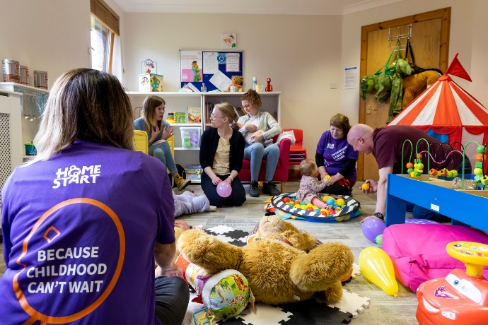
Childhood can’t wait for the economy to recover
Proposal to The Christopher Laing Foundation
Home-Start Erewash is changing futures
During early childhood, from pregnancy to age five, our brains undergo rapid development that influences our entire lives. Our experiences, relationships, and surroundings in those early years shape our physical and mental health, educational outcomes, ability to form relationships, and even our lifespan.
This critical period is where we start to comprehend the world, manage emotions, build relationships, develop resilience, and trust others. However, children's outcomes are closely tied to family circumstances, and when parents struggle, it becomes harder for children to thrive.
At Home-Start Erewash, we support parents in giving their children the best start. We recruit, train, and support volunteers who have personal insight into the challenges of parenting. These dedicated volunteers are carefully matched with families and provide weekly home visits for up to a year. By cultivating non-judgmental relationships and trusted friendships, our volunteers and families work together to address emotional and practical issues, finding solutions to move forward.
Together, we create a supportive, nurturing environment for children, making a profound impact on their physical and mental health, as well as their overall happiness. Each year, we work with over 140 families who are referred to us by various agencies including health visitors, children's services, GPs, schools, voluntary organisations, and mental health services. We offer not only one-to-one support, but also peer support groups, connection cafes, counselling, and a parenting programme.
Many of the areas we serve, across Derbyshire, face significant levels of deprivation. Cotmanhay in Ilkeston, for example, is one of the most deprived areas in the county. In such areas, health and social inequalities are deeply interconnected, leading to higher rates of poor mental health and increased stress among families. Approximately 20% of the families we support live in the 20% most deprived areas, and 20% of the children we work with are subject to child protection plans
“Home Start was my saving grace at a time when me and my family were so fragile. They picked out the best volunteer we could have ever wished for and I cannot begin to explain not only the sheer love and care we all felt from our very special volunteer when we needed it most, but also who truly helped in every aspect they possibly could.”

Slide 2
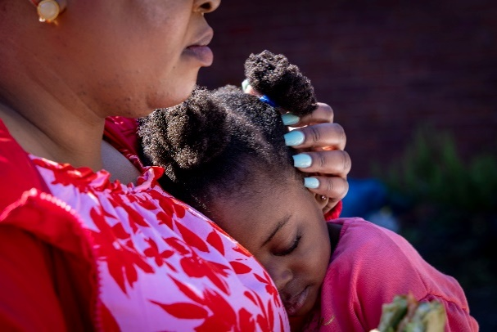
The Cost-of-Living Crisis is devastating families
No-one is left untouched by rising prices, inflation and economic uncertainty, but some families have been more affected than others and we know that this is having a detrimental impact on children. 30% of children living in Erewash are living in poverty yet 68% of these children live in working families struggling to find a way to make it better. It is a growing issue 88% of parents surveyed said the rising cost of living is putting their family under pressure. Increased food, housing, energy and childcare costs are pushing more families to the edge. The cost-of-living crisis is a disaster for families with young children.
Families that were already experiencing financial difficulties are facing challenges that now feel insurmountable. We expect these financial challenges to worsen over the coming year as interest rates continue to rise. Beyond the obvious challenges we have found that the crisis is limiting children’s access to socialisation and play both crucial for their development, socially and emotionally. Depriving them of these opportunities can have long-term consequences on their overall growth and happiness.
Helping young families cope through the crisis
Fiona, a single parent and carer for her own Mum, was struggling to cope financially and emotionally. With two young children and unable to work due to the cost of childcare she felt isolated and lonely. However, after joining our Connection Café in Ilkeston, things began to change for Fiona.
Through the café, Fiona met other parents in similar situations and formed new friendships. She started to thrive, until she faced the Cost-of-Living Crisis. Fiona confided in us, expressing her financial struggles and worries about the future. Despite her efforts to budget, rising costs made it impossible for her to make ends meet.
Fiona was particularly concerned about affording her daughter Evie's school uniform as she was about to start school. Trying to hide her worries from her children, Fiona maintained a brave face. But thanks to our generous supporters, we were able to provide Fiona with enough supermarket vouchers to purchase everything Evie needed for school, including shoes. Additionally, we made sure Fiona had enough vouchers to ease the cost of buying food for several weeks.
This support empowered Fiona to meet her
family's needs and restored her sense of
dignity and positivity. Evie was thrilled to
start school and loved her new uniform.

Slide 3
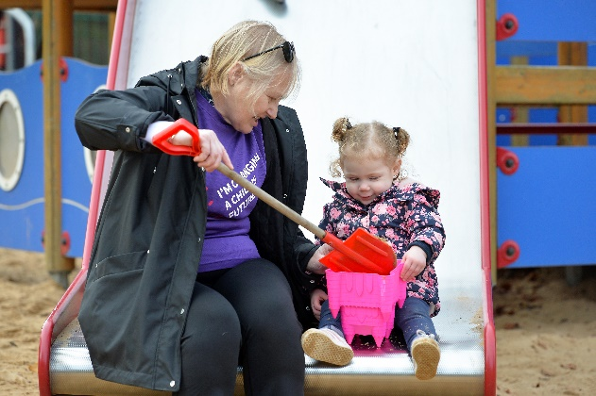
The struggles of our families are just one side of the story Our charity too is under pressure, facing increased demand, while recruitment of new volunteers has slowed down, and existing volunteers are having to make difficult decisions in view of their own household budgets. A decrease in volunteer numbers is making it more challenging to meet the needs of all of the families seeking our help. This places additional pressure on our staff to fill in the service gaps and provide support.
Our own costs have increased making delivering services to help families through these worrying times much harder. Furthermore, after years of pressure, increasing numbers of families are in crisis, with demand for our service rapidly increasing as they come to Home-Start with multiple and increasingly complex issues after being missed by statutory services during the pandemic. 74% of families are presenting with multiple complex needs.
To secure the futures of these children being
hit hardest by the cost-of-living crisis we need
funding to help us to recruit and train more
volunteers, keep our groups running and ensure
we can be there when families need us most,
because childhood can’t wait.
Reconnecting families and overcoming trauma
Jenny’s* journey is a testament to the transformative power of our support. As a recovering alcoholic, she came to us with very low confidence, anxiety and a deep sense of despair. She had been estranged from her children for 18 months due to her addiction and was eager to start rebuilding their relationship.
With our support, we addressed multiple barriers that had stood in Jenny's way. From confidence-building to child-friendly activities, food parcels, and housing assistance. Over time, Jenny gained more stability and moved from supported housing to a flat of her own.
The most significant progress came in the form of Jenny finally reconnecting with her children. Starting with regular meetings three times a week, Jenny was eventually able to transition to overnight stays. As a result reports show that the children have shown significant improvement in their well-being and overall happiness.
Jenny's progress has been so remarkable that she is now training to become a volunteer with us.
*name changed

Slide 4
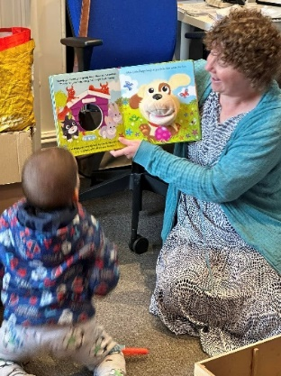
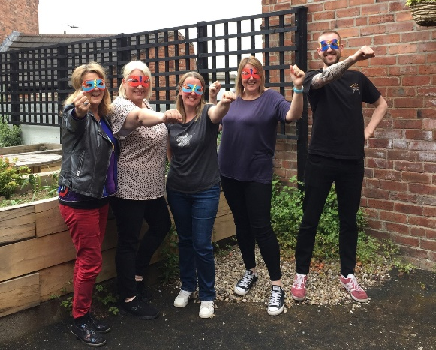
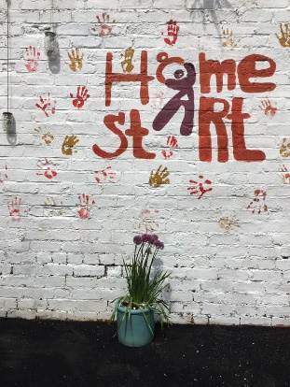
Childhood can’t wait, and neither will we
With your help Home-Start Erewash can offer families more support through these difficult times
We wish for every family to have the support they need so that every child gets the best possible start in life. Right now, we need to provide urgent emergency support. By supporting Home-Start Erewash, you can change children’s futures.
A gift of £5000 could provide 5 families with 1:1 weekly emotional support and practical help delivered by one of our highly trained and carefully matched volunteers for the next six months.
A gift of £2000 could help 15 families attend our Connection Café where they will get a hot drink, a slice of cake and time together in a welcoming community space where they can meet other parents and access support from our team.
A gift of £1000 could help us run a parenting course to help parents to feel more confident and capable. “ The relationship with my son improved so much, when I made a few simple changes. “
A gift of £500 could help us recruit and train 10 new home visiting volunteers so that we can support more of the families that need our help.
A gift of £250 could fund 3 places on our Embrace, nurture group for children recovering from the covid pandemic.
Thank you for your consideration and for all that
you do to support good causes.

